Slide 1
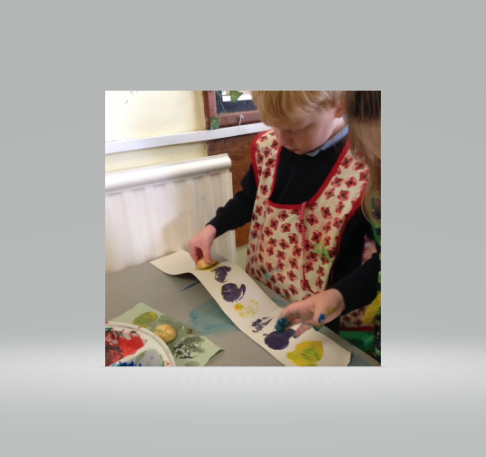
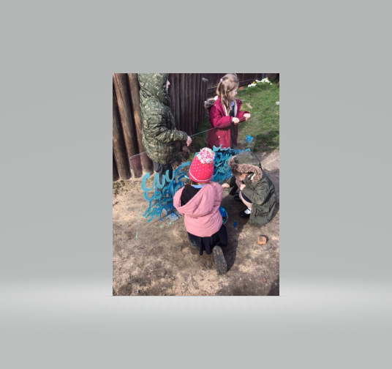
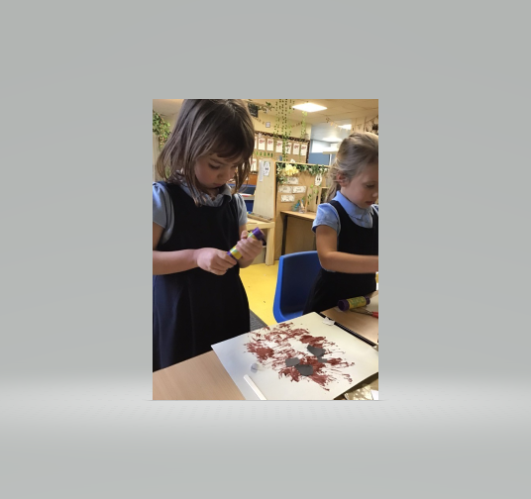
“I am a Hoyle court Artist”

Slide 2
“I am a Hoyle court artist” “I am reflective-I can make creative choices and decisions”
skills
Creativity
knowledge
“I am proficient in drawing, painting, sculpture and a range of other art, craft and design techniques”
“I can explore ideas, invent, imagine and problem solve”
“I know about great artists, craftspeople and designers and how they work. I can use some of this knowledge in my own work”

Slide 3
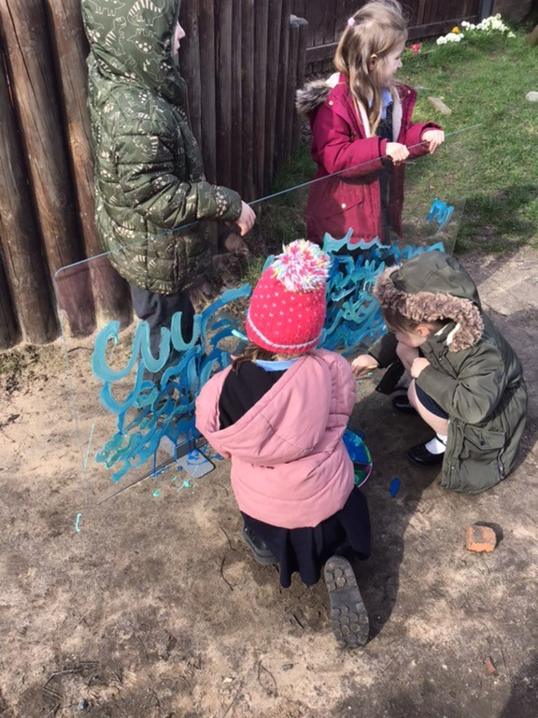
“I am a reception class artist”
ideas
making
evaluating
I can use my imagination and experiences to create my artwork
I can talk about and share my ideas
I am learning that my ideas might change and grow as I work
I am learning the skills to use and control a range of media and craft materials
I am learning how to use materials to create different effects
I can make choices about how I work and the materials I use
I use my artwork to record and express my thoughts and feelings
I can talk about similarities and differences in my work and that of others and share how the artwork makes me feel
I can talk about my thoughts and ideas and some of the techniques I have used

Slide 4
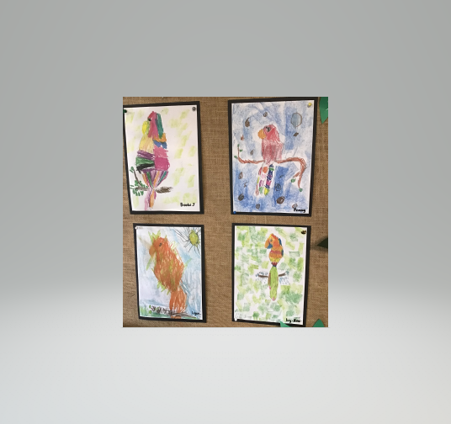
“I am a year 1 artist”
Ideas
making
evaluating
I can express my ideas through thinking, talking and doing
I can experiment and explore with an open mind
I use drawing to record and discover ideas and experiences
I can try out a range of materials
I can explore new materials
I can use materials purposefully
I am excited about being creative
I can invent and discover
I am interested in other people’s work and can talk about what I see
I can show pleasure in my work and talk about the process

Slide 5
“I am a year 2 artist”
Ideas
making
evaluating
I can express my ideas through thinking, talking and doing
I can experiment and explore with an open mind
I can make my own choices about what to do next
I use drawing to record and discover ideas and experiences
I am beginning to use a sketchbook to record my ideas
I can explore a range of materials and know about some of their qualities
I can use materials purposefully
I am excited about being creative
I can invent and discover
I can choose techniques for a specific purpose
I am beginning to be able to use more control with the materials I use
I am interested in other people’s work and can talk about what I see- I can express clear preferences and give reasons
I can show pleasure in my work and talk about the process
I can evaluate my work during the process as well as at the end

Slide 6
“I am a year 3 artist”
Ideas
making
evaluating
I can gather and review information from different sources and use these to develop my ideas and intentions
I can use my sketchbook to record observations and thoughts, plan and shape my ideas
I am developing practical skills by experimenting with and testing the qualities of a range of materials and techniques
I can select appropriate materials and techniques to use in my own work
I am excited about being creative and can undertake my own exploration
I can show pleasure in my work and talk about the process
I can reflect on what I like and dislike in my work in order to improve it
I understand how evaluating during the process helps to develop my ideas

Slide 7
“I am a year 4 artist”
Ideas
making
evaluating
I can gather and review information from different sources and use these to develop my ideas and intentions
I can use my sketchbook to record observations and thoughts, plan and shape my ideas
I use my sketchbook to experiment, ask questions and be inquisitive
I use my sketchbook to gather inspiration to feed into my projects
I am developing practical skills by experimenting with and testing the qualities of a range of materials and techniques
I can select appropriate materials and techniques to use in my own work. I am applying technical skills learnt to improve the quality of my work
I am excited about being creative and can undertake my own exploration
I can show pleasure in my work and talk about the process
I can reflect on what I like and dislike in my work in order to improve it
I understand how evaluating during the process helps to develop my ideas
I use ideas from the work of others in my own work

Slide 8
“I am a year 5 artist”
Ideas
making
evaluating
I research and explore to initiate and develop my own ideas
I confidently use my sketchbook to record observations, develop my ideas, test materials, plan and record observations
I use my sketchbook to explore my own creativity, ask questions, be inquisitive and explore new ideas. I know my sketchbook can be imperfect and experiential
I am confident to investigate and explore new materials and search for new experiences
I use my technical expertise to help me make choices and create work which reflects my ideas and intentions
I feel confident and safe to take creative risks
I can regularly analyse and reflect on my progress during the development of a piece of work
I look at the work of others (artists and my peers) and can identify how to feed ideas into my own work

Slide 9
“I am a year 6 artist”
Ideas
making
evaluating
I investigate, research, test and explore ideas and plans to initiate and develop my own ideas
I can develop a range of ideas which show curiosity, imagination and originality
I use my sketchbook to explore my own personal creativity, ask questions, be inquisitive and explore new ideas. I know my sketchbook can be imperfect and experiential
I am confident to investigate and explore new materials and make intelligent and creative choices in order to create successful finished pieces of work
I refine my technical expertise to improve my mastery of materials and techniques
I feel confident and safe to take creative risks and enjoy the process
I can regularly analyse and reflect on my progress during the development of a piece of work
I look at the work of others (artists and my peers) and can identify how to feed ideas into my own work
I can provide a reasoned evaluation of my own work and that of professionals

